Slide 1


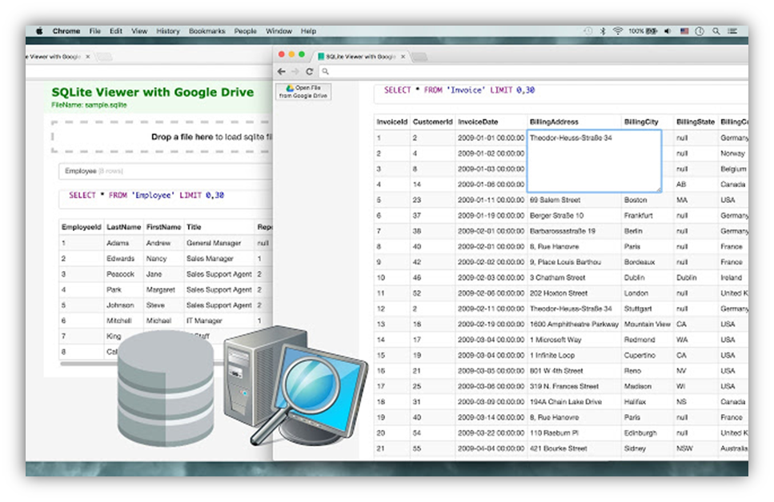
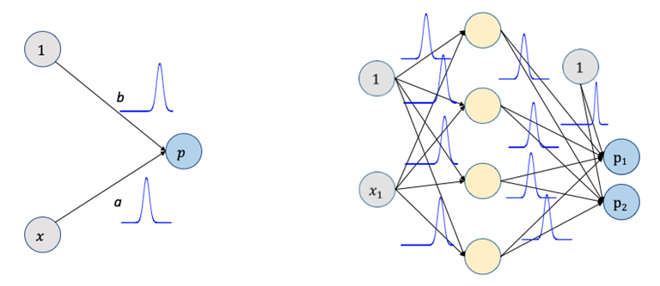
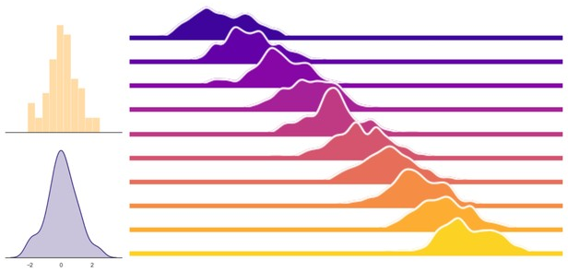
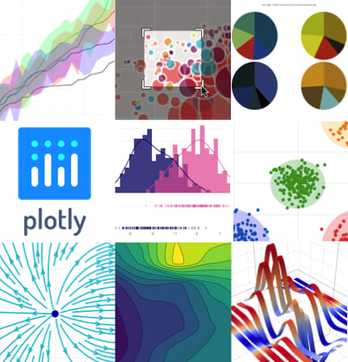
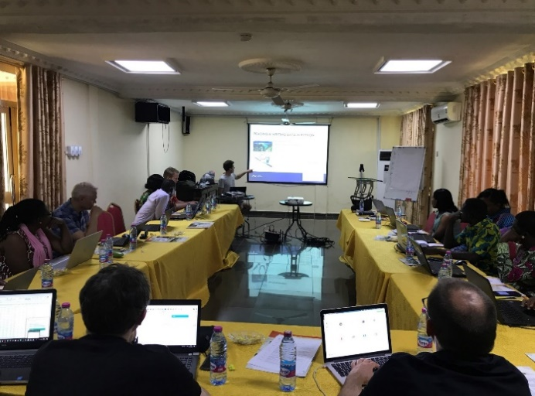
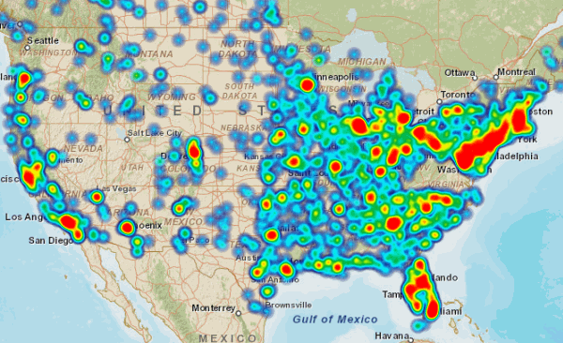





Coastal Community Resilience to Climate Change and Diarrhoea [C2R-CD] Project
WP 4: Integrated Assessment and Scenario Building
INTRODUCTION TO WORK PACKAGE
Prosper Adiku (PhD Student, IESS-UG)
The OVERALL GOAL of WP4 is to:
“generate statistical relations that estimate how key driving factors are influencing the occurrences of diarrhea, and further to build a software workflow around these relations that allow scenario simulations of diarrhea under future climate change and climate extremes.”
WP1: Biophysical and Climate Related Studies
WP2:
Public Health and Transmission Pathways
WP3: Community and Institutional Dynamics
SPECIFIC TASKS
Task 4.1: Organize data from WPs 1, 2 and 3 into Python compliant data structures (e.g. SQLite databases).
Task 4.2: Test an array of statistical approaches in terms of how well occurrence of diarrhea may be predicted from driving data provided by WPs 1, 2 & 3.
Task 4.3: Develop a Python-based workflow, which enable Monte Carlo simulations of scenarios through the most appropriate statistical model(s)
Task 4.4: Develop Python-based interactive visualizations of scenarios (e.g. using Plotly), which can feed into dissemination activities in WP5.
Task 4.5: Deliver a training course on data analysis and applied statistics in Python.
WP4:
Integrated Assessment and Scenario Building
WP5:
Community Involvement, Mobilization and Education for Impact
METHODOLOGY SUMMARY
TASK 4.1
TASK 4.2
TASK 4.4
TASK 4.3
TASK 4.5
Data Organisation into Python Compliant structures e.g. SQLite Database
Test different Predictive Statistical Approaches based on Data Available
Simulated Scenarios of Diarrhoea Incidence & Evolution
Develop Python-based interactive visualizations of scenarios (e.g. using Plotly)
Organise Capacity Building & Training Workshops
Tools/Simulated Scenarios of Diarrhoea
  Spatio-temporal evolution
  Projected diarrhoea risks & distribution
OUTPUTS
PhD Thesis/Publications
  Social Media-based Citizen Science Tools
  Stakeholder Engagements
WP5: Community Involvement, Mobilization & Education for Impact
  WP4 Team
  WP Lead:
  Dennis Trolle (Prof., AU)
  WP Co-lead:
  Barnabas Amisigo (Research Scientist, UG)
  Ph.D. Student:
  Mr. Prosper Adiku (IESS, UG)
  Others:
  AU Team and WP Partners
C2R-CD Objectives and Impact
Understanding how Factors (climatic & non-climatic) interact to influence the onset and evolution (spatio-temporal) of Diarrhoea and its Management in Coastal Ghana
ACKNOWLEDGEMENT
This Poster was prepared with the support of the WP4 and Project Management Team of the C2R-CD Project

