Slide 1


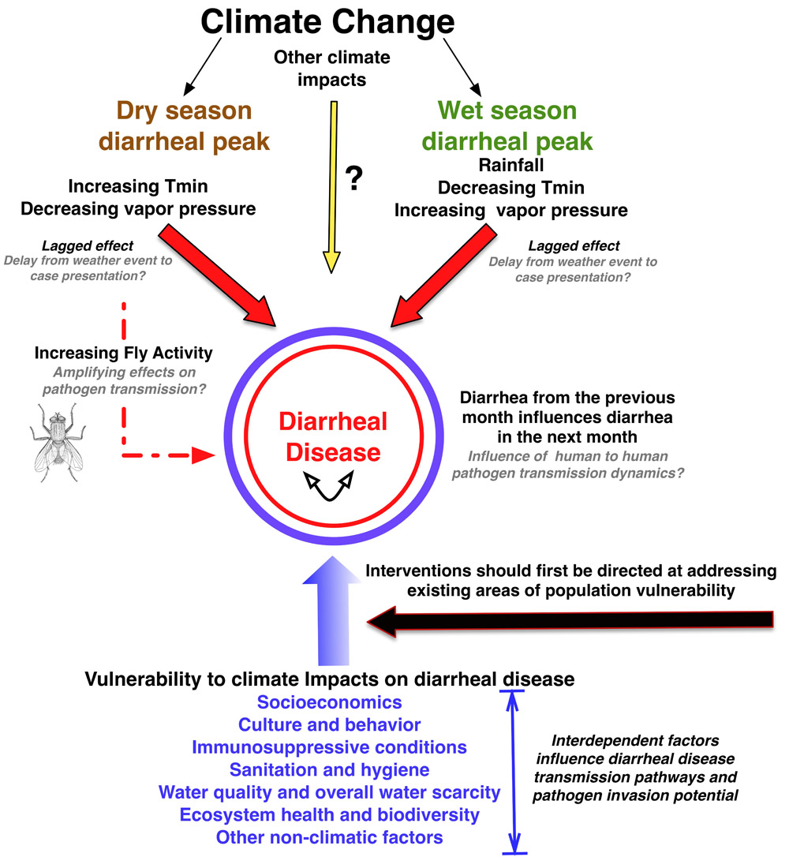






Coastal Community Resilience to Climate Change and Diarrhoea [C2R-CD] Project
WP 2: Public Health and Transmission Pathways
WP2 RECONNAISANCE TRIP TO EAST COAST OF GHANA
Delia A. Bandoh^{1,2}, D. Yirenya-Tawiah^{1,3}, T. Anang^{1,3}, F. Aboagye^{1,4}. M. Dzodzomenyo^{1,2}
(1-WP2 C2R-CD Project, 2-University of Ghana School of Public Health, 3-IESS-UG, 4-DABCS-UG)
INTRODUCTION
PRELIMINARY FINDINGS
Variable | Community
 | Mumford | Opetekwei
Health facility | Two, all reporting in DHIMS 2 | None
Water Sources | Rain water, polytanks, standing pipes | Public water tanks, public pipe stands, wells
Toilet facilities | KVIPS | Public and private toilets
Other observations | Refuse sites close to water source | Poor drainage systems
Overall Goal of WP2
Establish linkages between epidemiological and environmental determinants of diarrhoea
Reconnaissance trip to assess sites conducted
A good rapport established with stakeholders
Preliminary information needed on all sites collected
Contact numbers taken for information follow up
OBJECTIVES
TAKE HOME MESSAGES
Obtain preliminary information on demographics and practices of study sites
Assess feasibility of carrying out various study activities in these sites
Reconnaissance visit
  Important for getting buy in of community
  Provided team with a better understanding of site
  Important in assessment of feasibility of activities
APPROACH
  Community engagement
  Transverse walk
  Interviews – health seeking practices
  Checklist - water hygiene and sanitation practices
NEXT STEPS
Determine diarrhoea patterns from health records
Household surveys on WASH patterns
Enviromental assessments on WASH Structures
ACKNOWLEDGEMENT
We would like to acknowledge all assembly men, unit committee members and all opinion leaders of Mumford and Opetekwei
REFERENCES
Tech V. (2013) Climate change likely to worsen threat of diarrheal disease in Botswana, arid African countries. Earth. Phys.org. https://phys.org/news/2013-03-climate-worsen-threat-diarrheal-disease.html
Community engagement with opinion leaders at Mumford

