Slide 1

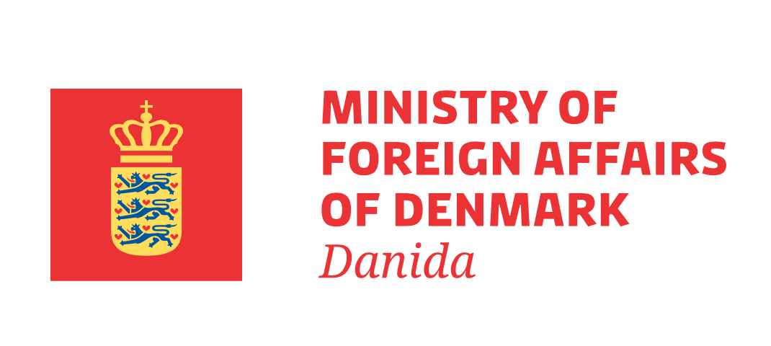






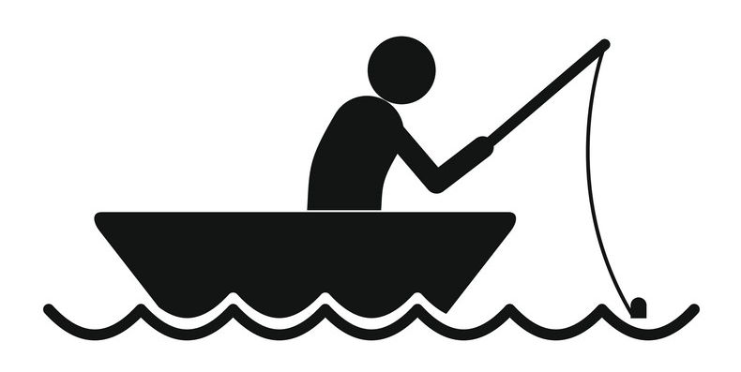


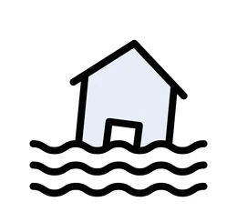


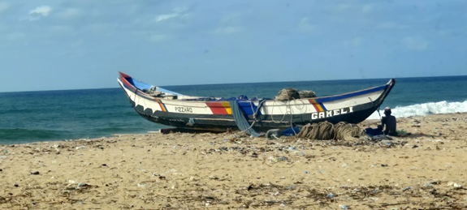
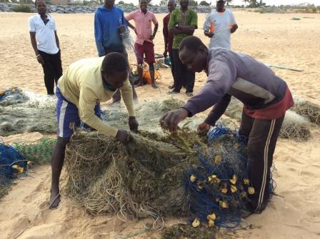
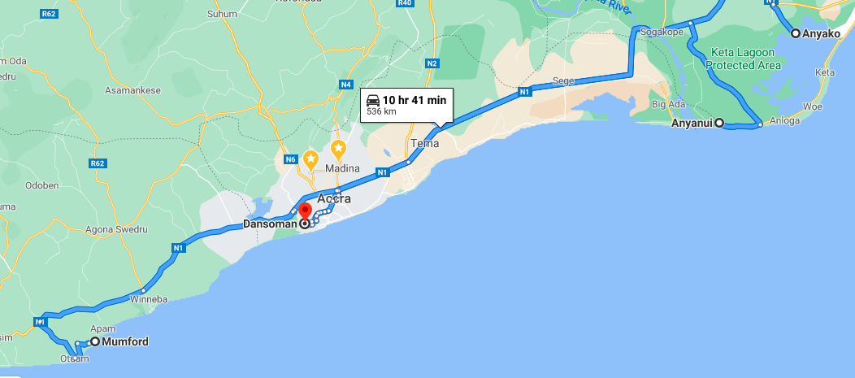
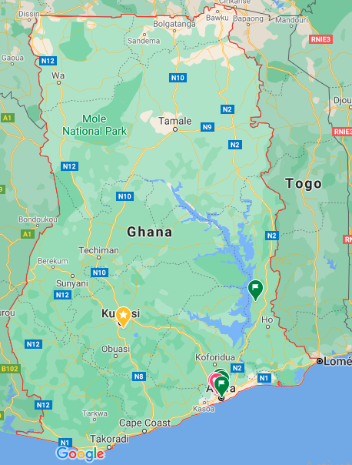






Coastal Community Resilience to Climate Change and Diarrhoea [C2R-CD] Project
Work Package (WP) 3: Community and Institutional Dynamics
WP 3 aims at investigating the institutional and governance (demographic, cultural, economic and political) barriers and enablers of effectively managing diarrhoeal diseases in coastal communities
WP 3 TEAM : Fidelia Ohemeng- Lead || Yaw Agyeman Boafo-Co-Lead || Jesse Ayivor|| Peace Dziedzom Gbeckor - Kove || Christian Damgaard|| Ebenezer Kwabena Appah-Sampong|Dzidzo Yirenya-Tawiah |
PhD Student: Joseph Ayitiah
Background
Reconnaissance Survey Findings
COMMUNITIES
INSTITUTIONS
RESILIENT SOCIO-ECOLOGICAL (COASTAL) SYSTEM
Status of C2R-CD study communities’
Socio-economic | Environmental
Fisheries livelihood dominate. Others include driving, masonry (All) | Open defecation a major concern (All)
Fish yield declining time (All) Majority of youth unemployed (All) | Scarcity of land (viz Anyako) Sea defense wall helping deal with erosion (Anyanui)
Rise in youth out-migration (All) | Lack of potable drinking water (All)
Health | Institutional
Diarrhoea prevalence variable: reducing (Anyako) and increasing (Mumford) | Traditional leadership and authorities have limited influence (All)
Poor sanitation conditions (Esp. in Mumford, Anyako) | Formal institutions e.g. NADMO are under-resourced
Inadequate health infrastructure to serve growing population (All) | Queenmother influence largely over women
Approach and Methodology
INSTITUTIONAL AND GOVERNANCE BARRIERS AND ENABLERS IN DIARRHOEAL MANAGEMENT
Characterize communities and risk levels
Examine formal and informal practices as influencers of diarrhoea and climate-related hazards
RELEVANT INSTITUTIONS AND STAKEHOLDERS
Socio-cultural beliefs and practices as drivers of diarrhoeal infection and management
NATIONAL
C2R-CD: RESILIENCE IN COASTAL COMMUNITIES TO CLIMATE CHANGE AND DIARHOEA
REGIONAL/DISTRICT
Stakeholders perception and knowledge [use, sharing and dissemination strategies}
COMMUNITY
GIS & down-scaling training
Assess local governance systems addressing climate-related disease outbreaks
GH. HEALTH SERVICES
NADMO
CHIEFS
CC down-scaling
Community Health System Capacity To Manage Diarrhoea
Fishing canoe at the coast al community of Anyanui, Anlo District
NGOs
EPA
QUEENMOTHERS
Development of community risk and resilience matrix
MEDIA
RELIGIOUS GROUPS (CHURCHES, MOSQUES TRADITIONALIST etc)
HOUSEHOLD
INTERVIEWS
FOCUS
GROUP DISCUSSIONS
WORKSHOPS
KEY INFORMANT INTERVIEWS
OBSERVATIONS
POLITICIANS/MPS
HEALTH DIRECTORATE
OUTPUT
COASTAL DEVT AUTHORITY (CODA)
SOCIAL WELFARE
Analysis of policy and institutional landscape for coastal community resilience to diarrhoea
  Policy Brief
  Peer review papers
Community Resilience Matrix
RADIO/TV STATIONS
1
FISHERFOLK GROUPS
Fisherman untangling their nets
Key institutions and stakeholders involved in diarrhoeal governance and management
Ongoing Activities
Fieldwork
  Household surveys
  Focus group discussions
  Key informant interviews
  Literature review
Study sites/communities
OPETEKWEI-GREATER ACCRA
ANYAKO-VOLTA REGION
ANYANUI/ATITETI-VOLTA REGION
MUMFORD-CENTRAL REGION

