Slide 1


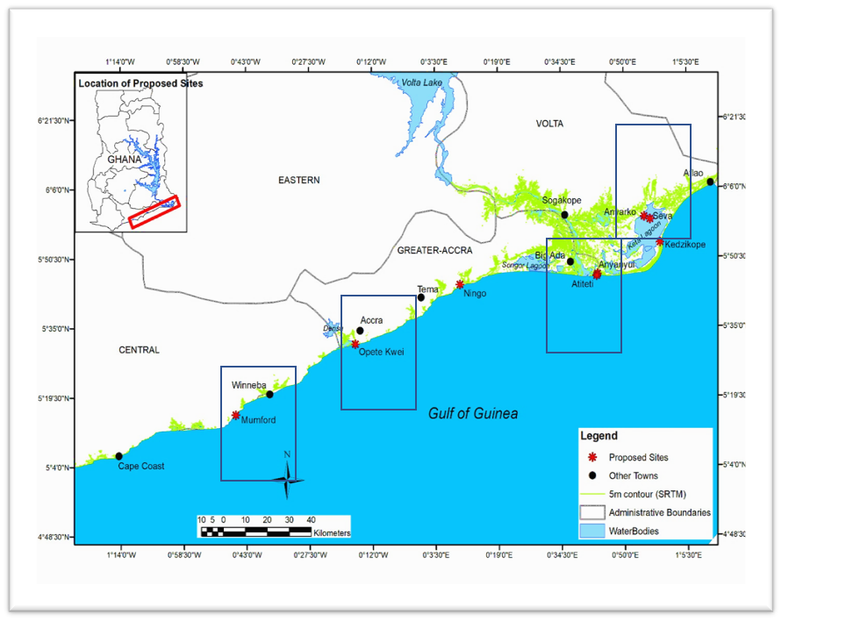
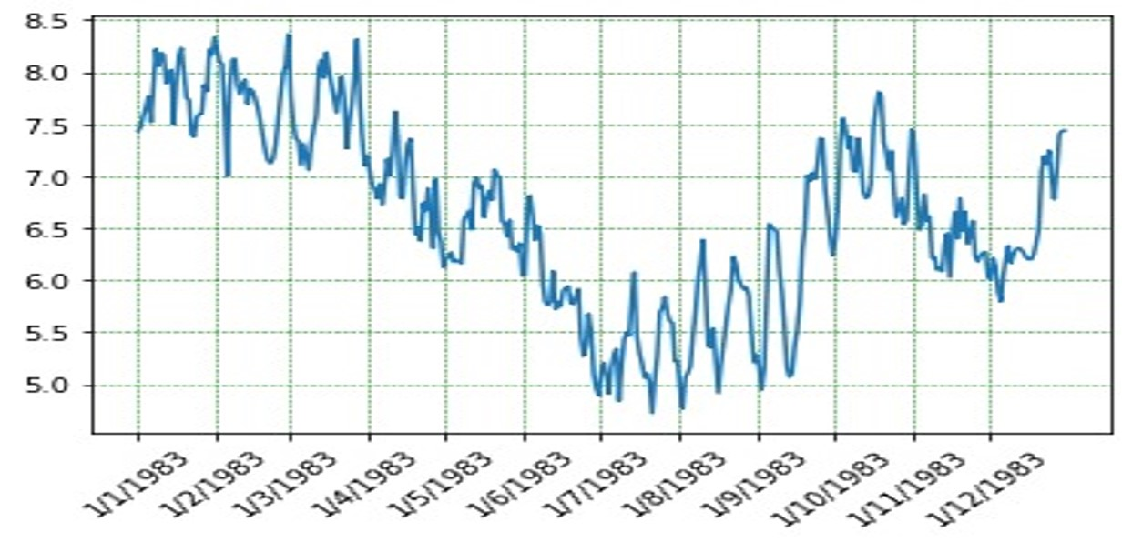
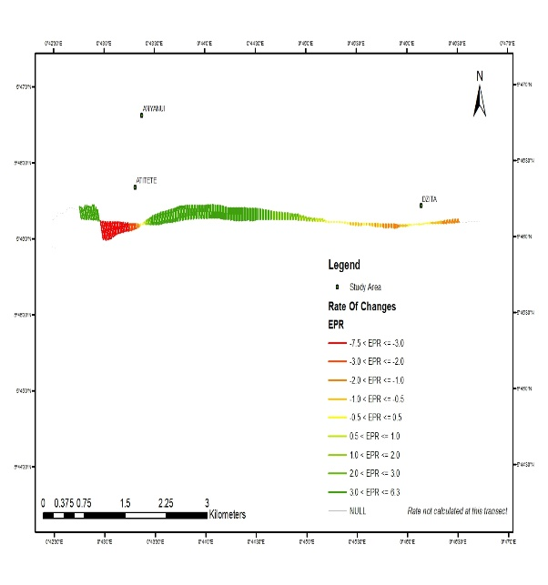
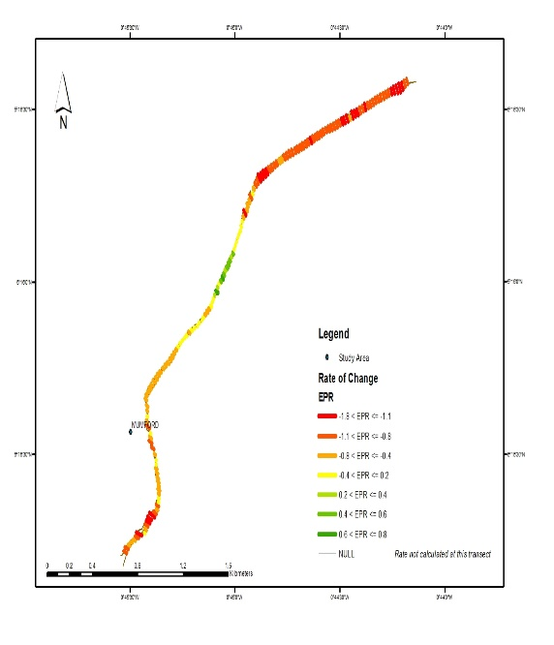
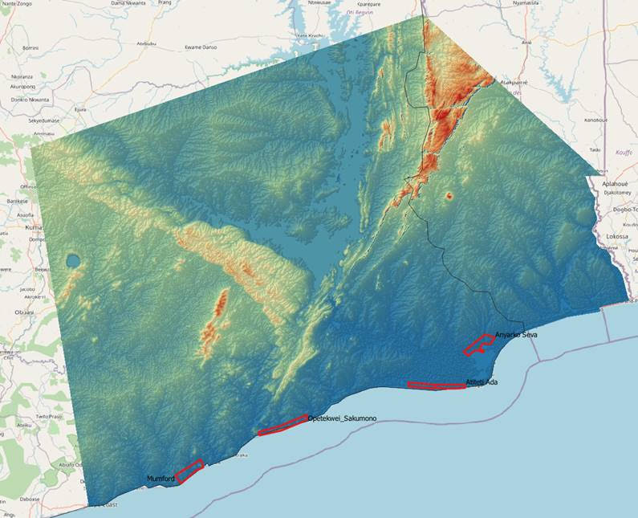





Coastal Community Resilience to Climate Change and Diarrhoea [C2R-CD] Project
WP 1: Biophysical and Climate Related Studies
INTRODUCTION TO WORK PACKAGE
Appeaning Addo, K., Botwe, B., Nukpezah, D., Jayson Quashigah, P N., Kwame-Biney, M., (UG) Nielsen, A (AU)
INTRODUCTION
Water dispersion data
Landscape storage dynamics
Historic flooding/ rainfall/temperature data
Coastal zones, particularly low-lying areas, are highly vulnerable to Sea Level Rise, flooding and erosion as a result of Climate Change and human interventions (Shepard et al., 2012)
Such situations as well as the biophysical environment will also affect transmission of human diseases such as diarrhoea(Checkly et al., 2003) with attendant socioeconomic impacts
Therefore, the overall goal of WP1 is to understand the role of the biophysical environment, including Climate Change, on the incidence of diarrhoea diseases in coastal communities
Acquire Climatic data from GMET
Beach profile data
MIKE 3 model/slum
Python
(app) bayesian
Simulated flood prediction and scenarios (MIKE)
Shapefile from ARCMAP
Historic diarrhoea data
Simulated flood prediction and scenarios
Predict diarrhoea prevalence
Figure 3: A diagram showing the approach to Objective 4
Establish Ground Control Points
Setup flight plan
Acquire DEM
Acquire orthophoto
Morphodynamics parameter
Shoreline declination
Beach profile
Sediment volume change
Figure 4: A diagram showing the approach to Objective 5
PRELIMINARY RESULTS
Figure 5: Plotted Sea Level Data
Figure 1: A map of the Ghana coast showing the study areas
OBJECTIVES
Characterize the biophysical environment and climatic conditions of identified coastal ecosystems in selected case study sites
Acquire and process meteorological time series data
Generate land-use and elevation maps
Test a range of hydrological approaches (eg Malstroem)
Assess the role of climate change induced SLR and storm surge in driving flooding events in the study area.
Figure 6: DEM from 30m SRTM data
Figure 7: EPR of Mumford & Atiteti
MILESTONES
Acquisition of historical climatic dataset
Initial estimation of erosion rates at two sites (Mumford and Atiteti beaches) done using the end point rate approach from DSAS
One-year modelled Sea Level data cleaned and plotted using python
Monthly sampling and subsequent analysis of seawater, groundwater and surface water ongoing
APPROACH
Acquire/Analyze WV & GE Data
Historic rainfall/temperature from GMET
Acquire DEM data
Identify flood prone areas and characterize biophysical env.
Examine the link between rainfall/temperature and diarrhoea
NEXT STEPS
Establish TBM (GCPs) and start Drone flights
Calculate erosion rate of study areas with current data
Acquire DEM and MIKE 3 license
Continue monthly sampling and subsequent analysis of seawater, groundwater and surface water
Generate maps using GIS tools
Historic diarrhoea data from GHS
Use information from map to create LCCS classes
ACKNOWLEDGEMENT
Figure 2: A diagram showing the approach to Objectives 1,2 and 3
This poster was prepared with the support of the WP1 members and Project Management of the C2R-CD Project

